Slide 1

Azure DevOps

Slide 2
What is DevOps?
People. Process. Products.
Build& Test
Deploy
DevOps is the union of people, process, and products to enable continuous delivery of value to your end users.
“
Continuous Delivery
Develop
Operate
”
Plan & Track
Monitor & Learn
@DonovanBrown

Slide 3





Introducing Azure DevOps
Azure Boards
Azure Pipelines
Azure Repos
Deliver value to your users faster using proven agile tools to plan, track, and discuss work across your teams.
Build, test, and deploy with CI/CD that works with any language, platform, and cloud. Connect to GitHub or any other Git provider and deploy continuously.
Get unlimited, cloud-hosted private Git repos and collaborate to build better code with pull requests and advanced file management.
Azure Test Plans
Azure Artifacts
➔
Test and ship with confidence using manual and exploratory testing tools.
Create, host, and share packages with your team, and add artifacts to your CI/CD pipelines with a single click.
https://azure.com/devops
@DonovanBrown

Slide 4

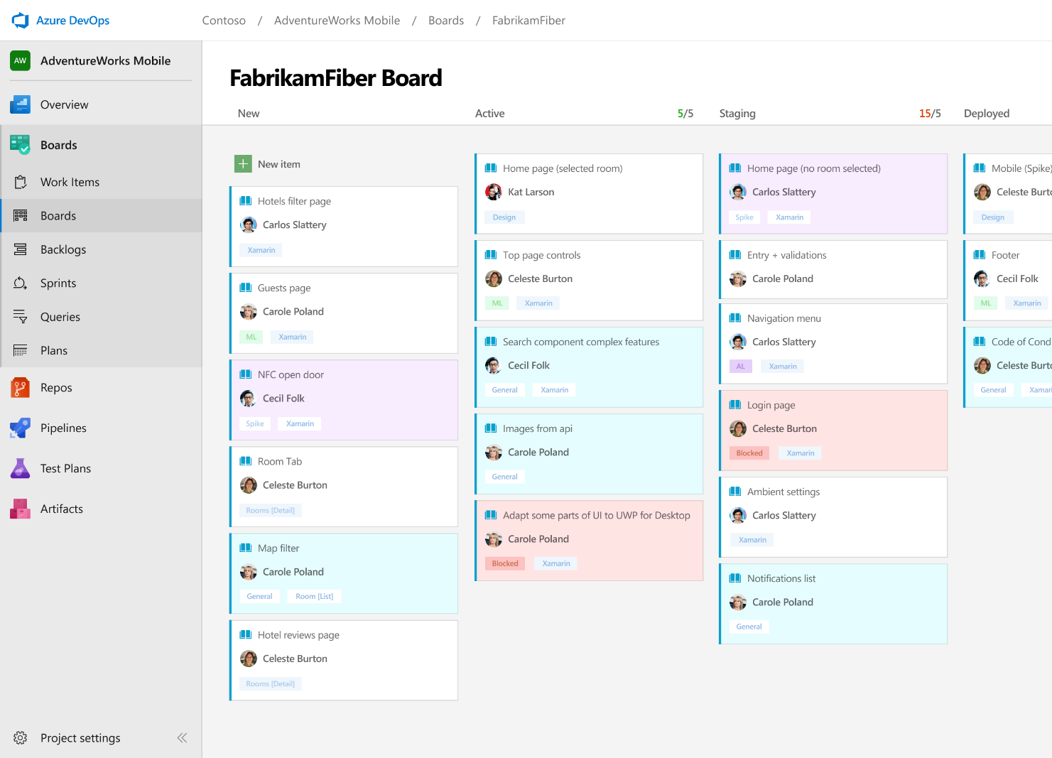



Azure Boards
Track work with Kanban boards, backlogs, team dashboards, and custom reporting
Connected from idea to release
Track all your ideas at every development stage and keep your team aligned with all code changes linked directly to work items.
Scrum ready
Use built-in scrum boards and planning tools to help your teams run sprints, stand-ups, and planning meetings.
Project insights
Gain new insights into the health and status of your project with powerful analytics tools and dashboard widgets.
➔
https://azure.com/devops
@DonovanBrown

Slide 5
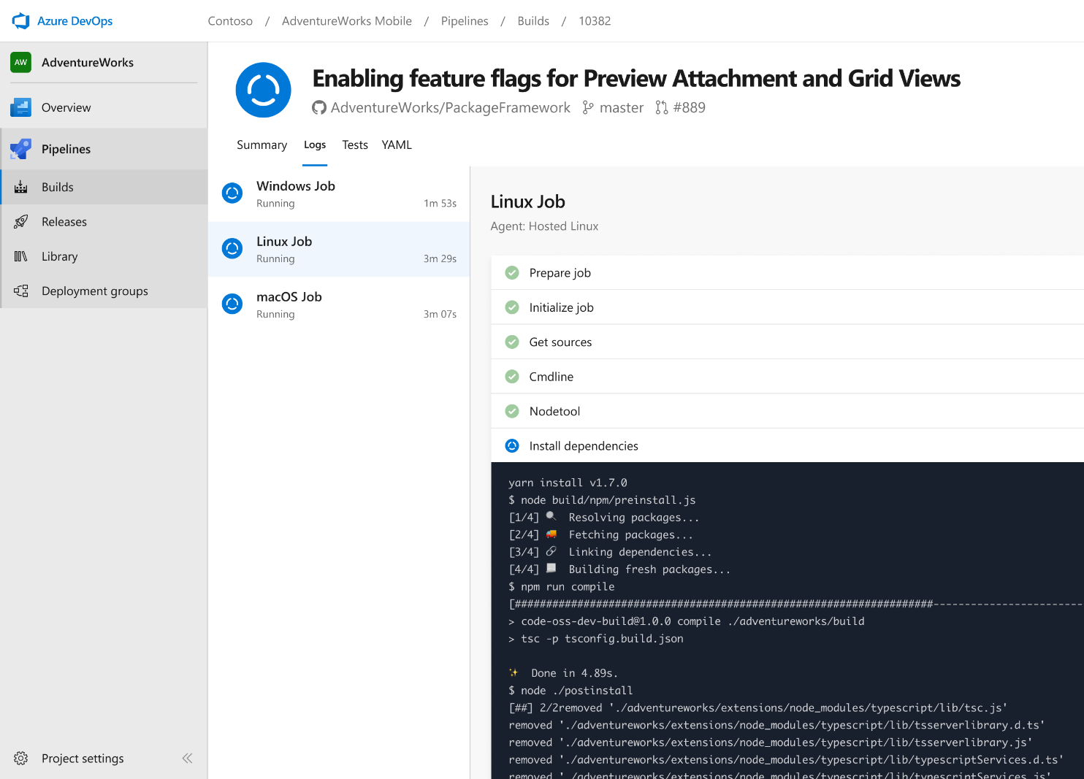


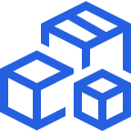

Azure Pipelines
Cloud-hosted pipelines for Linux, Windows and macOS, with unlimited minutes for open source
Any language, any platform, any cloud
Build, test, and deploy Node.js, Python, Java, PHP, Ruby, C/C++, .NET, Android, and iOS apps. Run in parallel on Linux, macOS, and Windows. Deploy to Azure, AWS, GCP or on-premises
Extensible
Explore and implement a wide range of community-built build, test, and deployment tasks, along with hundreds of extensions from Slack to SonarCloud. Support for YAML, reporting and more
Containers and Kubernetes
Easily build and push images to container registries like Docker Hub and Azure Container Registry. Deploy containers to individual hosts or Kubernetes.
Best-in-class for open source
Ensure fast continuous integration/continuous delivery (CI/CD) pipelines for every open source project. Get unlimited build minutes for all open source projects with up to 10 free parallel jobs across Linux, macOS and Windows
➔
https://azure.com/pipelines
@DonovanBrown

Slide 6
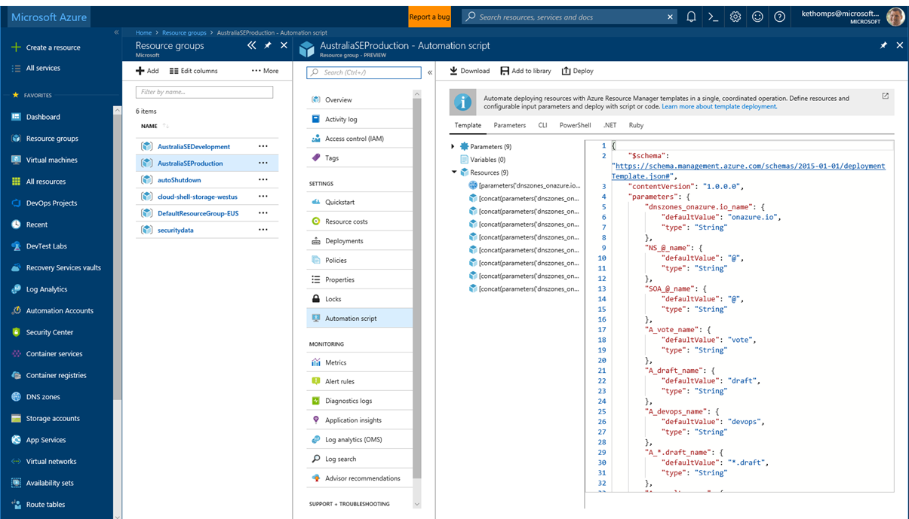
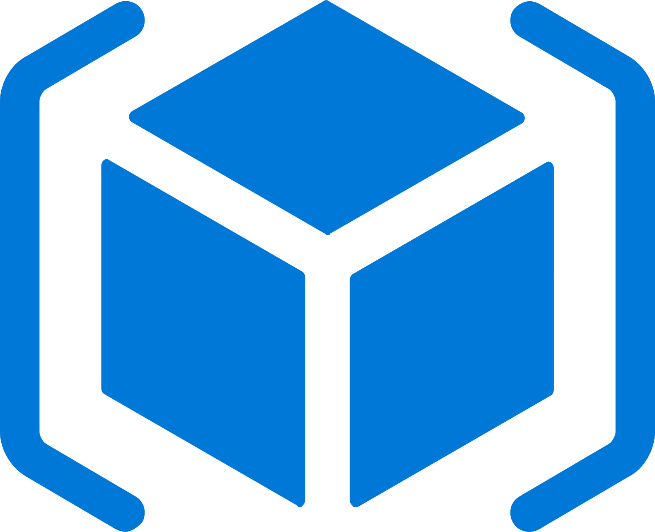


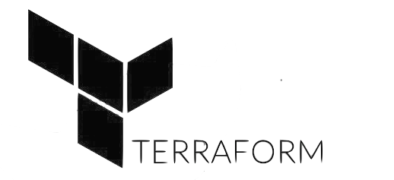
Deploy Repeatedly & Reliably
Azure Resource Manager & DevOps Tool Integrations
Infrastructure as Code, built-in with Azure Resource Manager
Use Azure Automation & Config to automate repetitive tasks
Support for DevOps tool integrations and OSS tooling such as Terraform, Ansible & Chef
@DonovanBrown

Slide 7
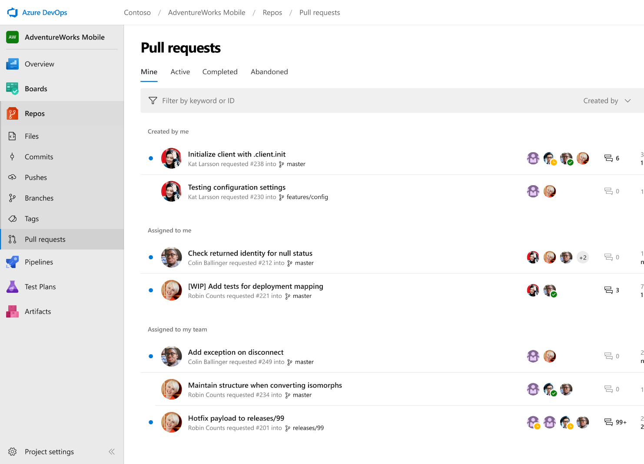



Azure Repos
Unlimited private Git repo hosting and support for TFVC that scales from a hobby project to the world’s largest Git repositories
Works with your Git client
Securely connect with and push code into your Git repos from any IDE, editor, or Git client.
Web hooks and API integration
Add validations and extensions from the marketplace or build your own using web hooks and REST APIs.
Semantic code search
Quickly find what you’re looking for with code-aware search that understands classes and variables.
➔
https://azure.com/devops
@DonovanBrown

Slide 8
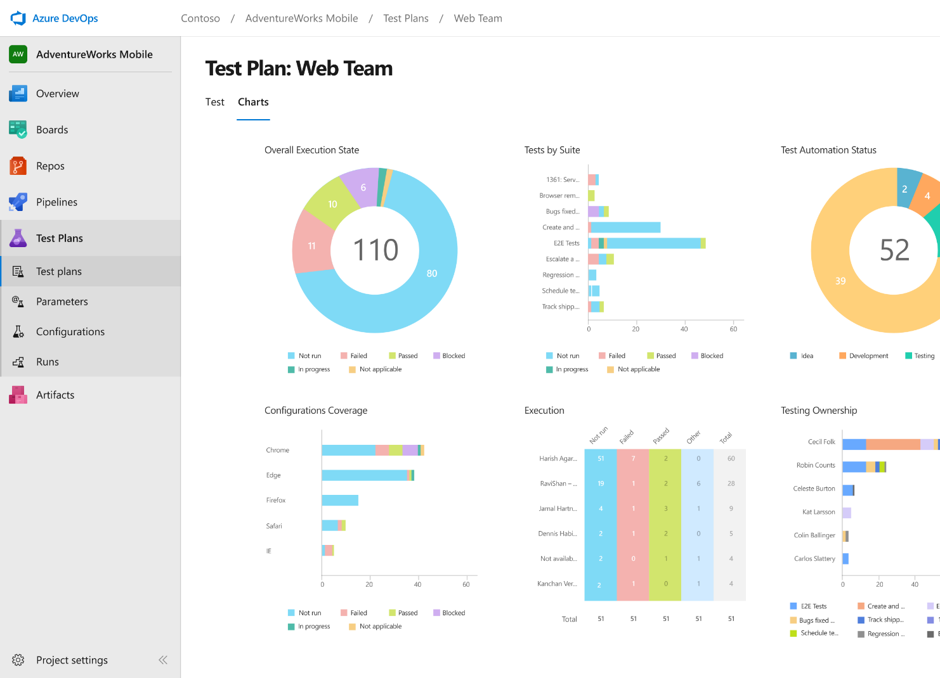
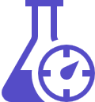


Azure Test Plans
Get end-to-end traceability. Run tests and log defects from your browser. Track and assess quality throughout your testing lifecycle.
Capture rich data
Capture rich scenario data as you execute tests to make discovered defects actionable. Explore user stories without test cases or test steps. You can create test cases directly from your exploratory test sessions.
Test across web and desktop
Test your application where it lives. Complete scripted tests across desktop or web scenarios. Test on-premises application from the cloud and vice-versa.
Get end-to-end traceability
Leverage the same test tools across your engineers and user acceptance testing stakeholders. Pay for the tools only when you need them.
➔
https://azure.com/devops
@DonovanBrown

Slide 9
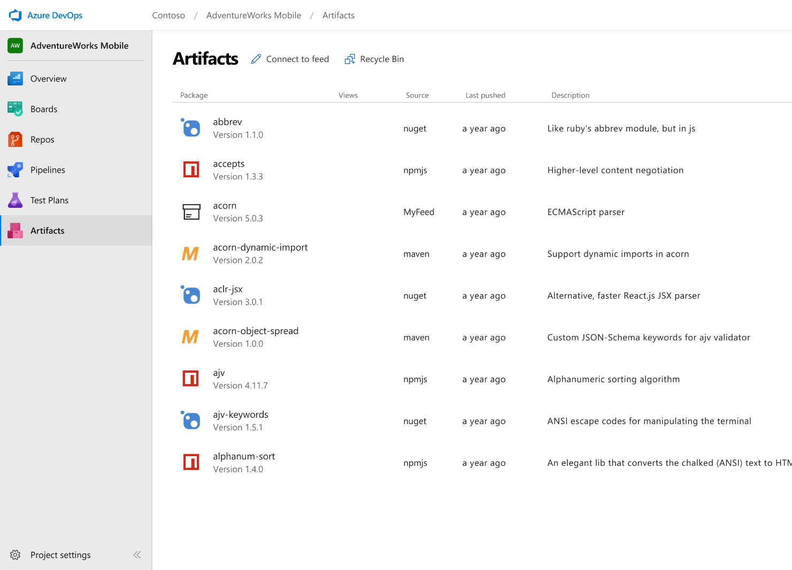



Azure Artifacts
Create and share Maven, npm, and NuGet package feeds from public and private sources – fully integrated into CI/CD pipelines
Manage all package types
Get universal artifact management for Maven, npm, and NuGet.
Add packages to any pipeline
Share packages, and use built-in CI/CD, versioning, and testing.
Share code efficiently
Easily share code across small teams and large enterprises.
➔
https://azure.com/devops
@DonovanBrown

Slide 10





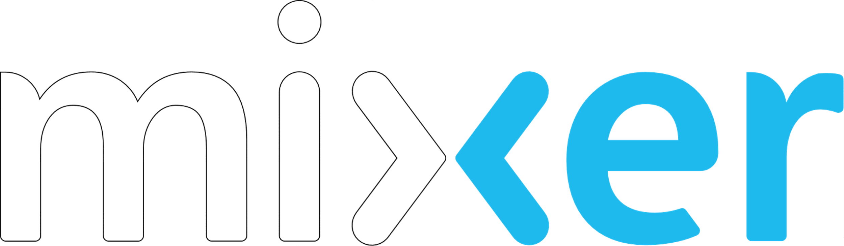
Azure DevOps
Plan smarter, collaborate better, and ship faster with a set of modern dev services
Any developer, any platform, any cloud. Full support for hybrid cloud, on-premises & containers.
Use all the Azure DevOps services or choose just what you need to complement your existing workflows
Best in class builds for open source. Free unlimited build minutes for public projects and up to 10 free concurrent pipelines across Windows, Linux and macOS
Get started for free for small teams, scales to support the largest enterprises
Azure Boards
Azure Repos
Azure Pipelines
➔
https://azure.com/devops
Azure Test Plans
Join us for a community livestream and Q&A
Azure Artifacts
Sept 17th 8:30am Pacific, 11:30am Eastern, 3:30pm UTC
https://aka.ms/AzureDevOpsLaunch
#AzureDevOps
@DonovanBrown

Slide 11
Q&A
@DonovanBrown

Slide 12

Thank You
@DonovanBrown

Slide 13
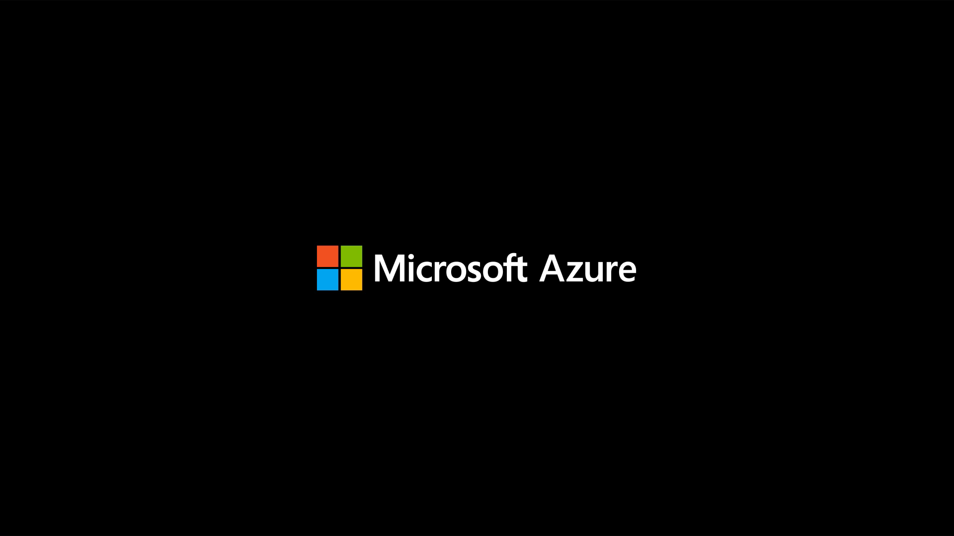
@DonovanBrown

